Slide 1

Reconnect and Rise
A selection of assembly and class based activities to support your school community as it comes back together again.

Slide 2
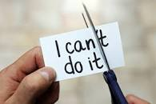
Section Two, Theme 1
Believing in Ourselves

Slide 3
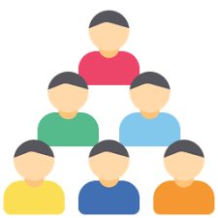
Believing In Ourselves
  Most of us will have experiences feelings of helplessness during lockdown, life changed so suddenly and it became difficult to predict what would happen next. With all of the restrictions and the constant news updates it was natural that we felt unsafe and that we had lost the ability to plan ahead.
  We used to stick together to stay safe and now we had to keep safe by staying apart, we couldn’t hug or shake hands and we had lots of new rules to follow.. I’m sure you know them all off by heart!
  Now as we emerge from lockdown that we all looked forward to so much- things can still feel scary and we can doubt ourselves and what we can do/
  We must now start to look after ourselves in a different way- by reconnecting with ourselves and rebuilding our confidence and self belief

Slide 4
Materials required- inspirational story of someone who demonstrated their self belief and used their strengths to the best of their ability
Step one: Introduce idea of self- belief and how this impacts on our motivation to try something; e.g. baking a cake, changing a tyre, running a 10k. If we believe we can do something we will give it a try if our mind set is no I can’t we won’t take that risk
Having self belief can reduce stress and reinforce our strengths to help us cope with challenges. I was able to do this before so I will try

Slide 5
Step Two: Story of an inspirational person who believed they could make a difference and did
Step Three: what obstacles and challenges did they face and overcome to maintain self-belief
Step Four: Self- Belief doesn’t mean instant success, but rather gives you the focus to keep moving closer to your goal one step at a time.

Slide 6
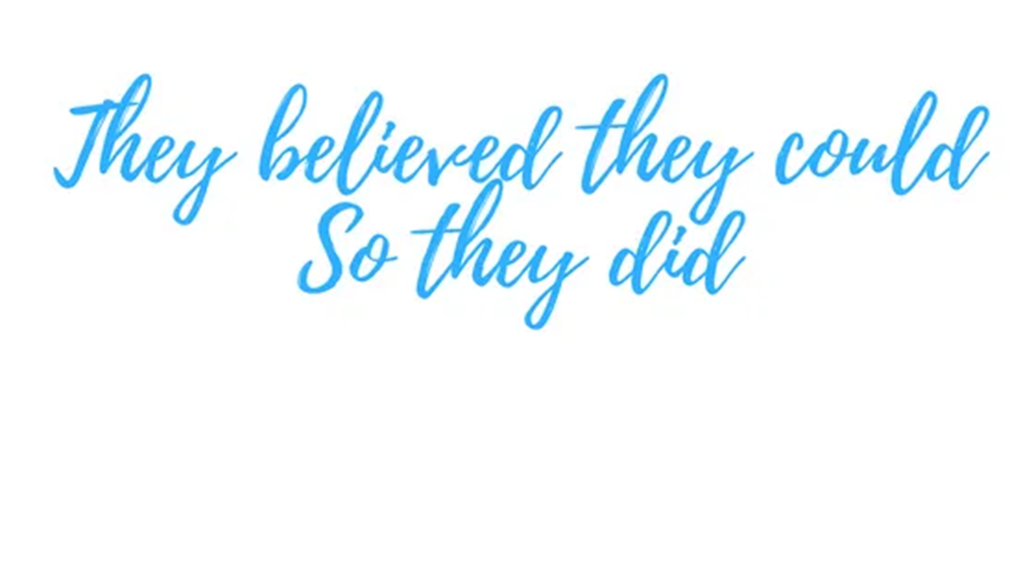
Why is this important?
Many of us have felt we have had no control during lockdown, exams were cancelled, events were called off and we began to feel helpless
As we move into this next phase it can be hard to feel motivated and believe that what we do in school now really matters.
Focusing on self belief helps us to remember our strengths what we have achieved and what we have coped with before.

Slide 7

Marcus Rashford
Greta Thunberg
Captain Tom
https://www.youtube.com/watch?v=vyHZ8rbJQUQ
https://www.youtube.com/watch?v=KAJsdgTPJpU
https://www.youtube.com/watch?v=SwGWfRZH3oI

Slide 8
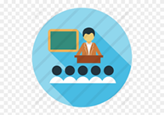
When we believe in ourselves we believe that we can make a difference
This helps remind us of our strengths and what we can achieve
When we believe in ourselves we begin to RECONNECT with our hopes and dreams and become more motivated and empowered

Slide 9

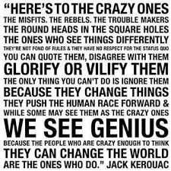

Slide 10
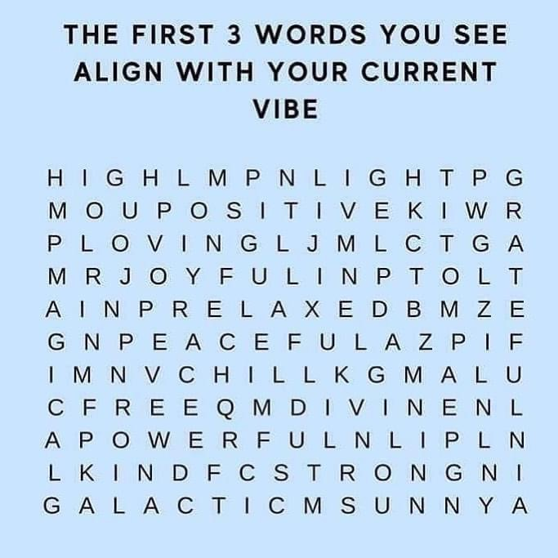

Slide 11
What words did you see? (Pair and share)
How would you have felt if the words you noticed were negative?

Slide 12
Notes for Teachers
Feeling you have no control- increases worry, anxiety and frustration
During times when we feel overwhelmed it is useful to focus on what we can do to make a difference- helping us feel more in control.
This is why your Instagram was flooded with people doing press up challenges, baking banana bread, gardening and DIY because it gave us a sense of control and focus
In our local community what examples can we think of where people we know channelled these feelings into making changes for us all?
As we reconnect with school we will be paying more attention to our feelings to help us look after our mental health and wellbeing. We will be building up our toolkits to help extend our ways to cope and to look after ourselves

Slide 13
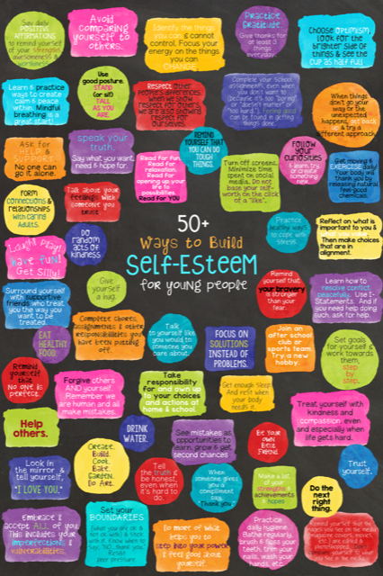

Slide 14
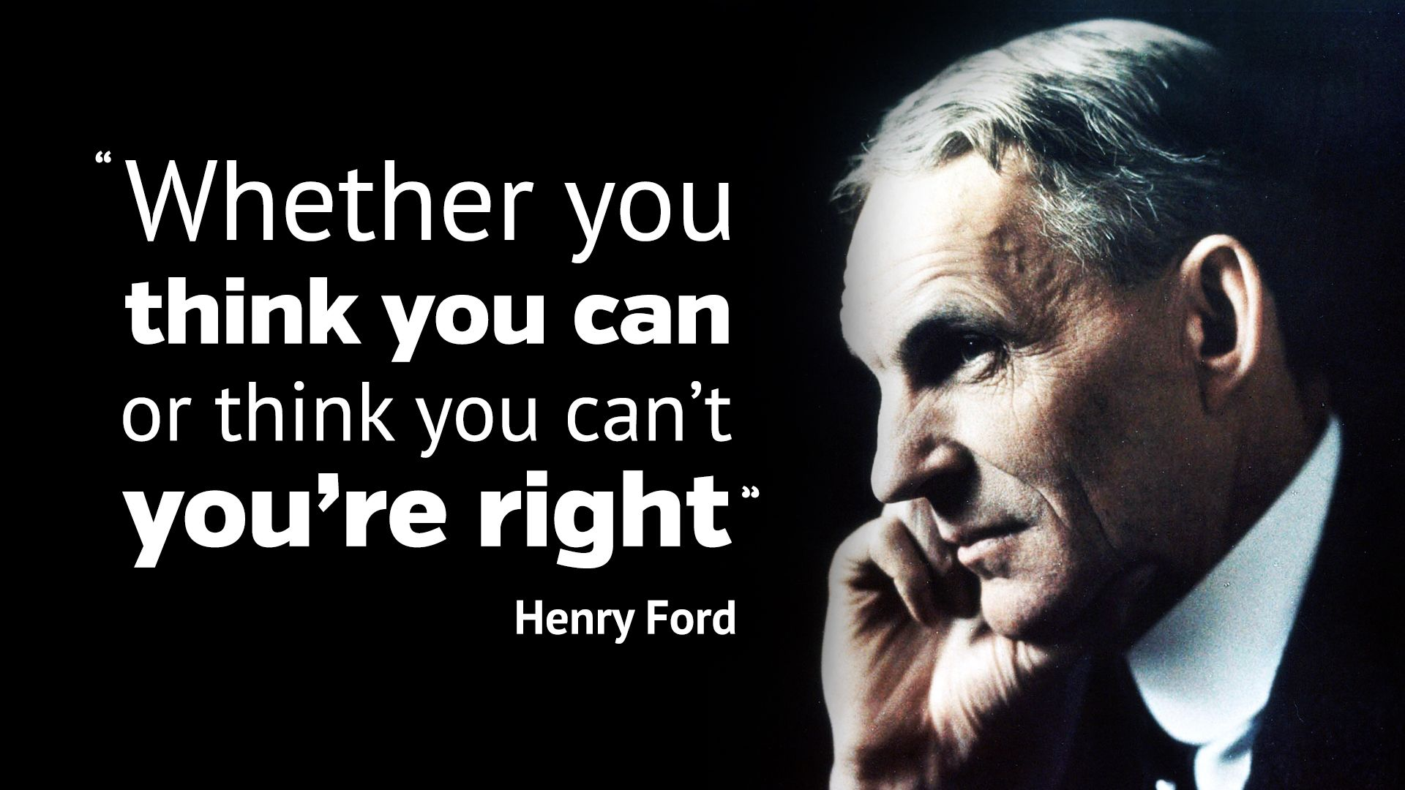

Slide 15
What do you think this quote means?
How does our self belief impact on our lives and achievements
Activity- Flip it Reframe the phrases (Appendix i
Mindfulness- Silent sitting- guided meditation (Appendix ii)
Songs
Keep your head up https://www.youtube.com/watch?v=ADP65wbBUpc
The Climb https://www.youtube.com/watch?v=NG2zyeVRcbs

