Slide 1
Reconnect and Rise
A selection of assembly and class based activities to support your school community as it comes back together again.

Slide 2
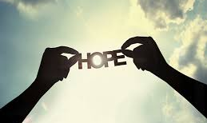
Section Two, Theme 3 Resilience/Hope

Slide 3
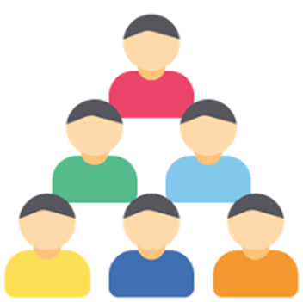
Materials- story of a famous failure examples include J.K. Rowling,
Walt Disney, Jeff Besos and Steve Jobs
We would never recognise these names or know of Harry Potter, Disney World, Amazon or Apple if these people had quit when they failed
What can we learn from them?
Don’t Quit –poem
How can we use this for our everyday lives and our return to school
We as a school are stronger together- without you our school community would not exist- YOU ARE IMPORTANT

Slide 6
Reminders of how to ask for help in school Safeguarding team/Counselling services/Pastoral Team etc.
Safe Hand activity to be done in all form classes

Slide 7
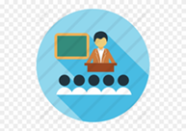
What is Resilience?
Resilience is the ability to cope when things go wrong.
Resilience can also be described as:
Bouncing back after difficult times
Dealing with challenges and still holding your head up
Giving things a go or trying your best
Being strong on the inside
Being able to cope with what life throws at you and shrug it off
Standing up for yourself

Slide 8
On each finger add the name of someone you can ask for help in school or at home

Slide 9
What helps develop resilience?
Some things that can help develop resilience are:
Having a positive attitude
Finding good friends
Feeling good about yourself
Feeling like you belong
Having a supportive family
Helping others or 'giving back'
Being able to solve problems and overcome challenges
Good communication with the people around you

Slide 10
Why is Resilience important now?
Everyone has had a different experience of lockdown and whilst all of our worlds were thrown upside down by the Covid 19 Pandemic each one of us will have been impacted in various ways
It is completely normal to feel hopeless and overwhelmed as we return to school- I have missed so much, how will I catch up, or I miss home I have really enjoyed being in lockdown.. That extra time in bed in the mornings was great! Simple things like following rules, wearing our uniform coupled with the ‘new normal’ can make us feel overwhelmed.
We are focusing on HOPE which is intertwined with Resilience

Slide 11
Ways we can build our resilience
Class discussion- we each carry a backpack of experience that builds our resilience- teachers can model this e.g. Parents/Carers/Friends support, Teachers encouragement, not giving up, asking for help
Class posters – make a poster to remind us of ways that we can build our resilience and look after our health and wellbeing

Slide 12
What experiences do we carry around with us that have made us more resilient?

Slide 14
“Hope is the personal rainbow of the mind”
Activities in class
Safe hand- Outline of hand- 5 people you can ask for help in school
Class Rainbows- symbols of shared hope
What are we looking forward to?
What are we worried about?
Solution Circle- how can we manage these fears.. Helpful actions

