Slide 1
Reconnect and Rise
A selection of assembly and class based activities to support your school community as it comes back together again.

Slide 2
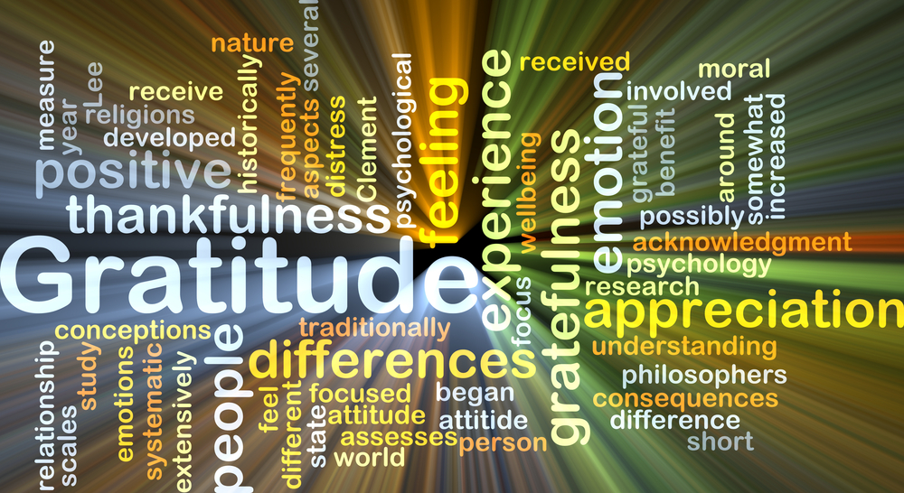
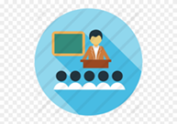
Section Two, Theme 4 Gratitude

Slide 3
Appreciation/Gratitude
As we continue to focus on looking after our wellbeing we turn our attention to Gratitude
Materials- you tube clips about science of gratitude and how negative thoughts impact on our wellbeing
Reference- Thank you NHS.. How practicing gratitude promoted a sense of appreciation and well being for us all during lockdown.
Activity- what are the things you really appreciated during lockdown?
Are we more thankful for small things now that we have experienced what it is like when they are taken away- unlimited exercise, youth club, group training for sport, choirs, socialising, shopping, eating out
Key Workers- in Lockdown we noticed and appreciated the key workers who often are taken for granted, we will try to remember how important all of these jobs are in our lives and not take things for granted anymore.
Challenge- This week we set you all the challenge to find five things everyday that you are grateful for

Slide 4
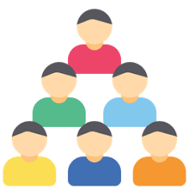
The science of gratitude https://www.youtube.com/watch?v=JMd1CcGZYwU
It’s the negative stuff that sticks
https://www.youtube.com/watch?v=3ThUrVXz9j0

Slide 5
Practicing Gratitude
When things get overwhelming often the negative thoughts can be the ones that take up the most space in our heads and drown out the positive things
Consciously practicing gratitude helps us tune into the positive things in our lives, a tool that is really important when things around us can seem so uncertain and negative
Often this can happen us at night or when we are alone when we don’t have those supportive positive people around us to guide us back to positivity

Slide 6
Mindfulness activity
Body scan – see guidance
3 Things that I can hear that I am thankful for
3 Things that I can see that I am thankful for
3 Things that I can smell that I am thankful for
3 Things that I can touch/feel that I am thankful for
3 Things that I can taste that I am thankful for

Slide 7
Follow up activities
Gratitude tree- 3 leaves from each pupil. I am thankful for
Gratitude jar- to keep the practice going have a jar in the form class where pupils can place one thing every week that they are thankful
Celebrate
People in our school community/local community we are thankful for
(Small group work)

Slide 8
Appendix i
Reframing
Group activity- reframe together how to switch these to more positive language
I’m useless at football what is the point of even trying
I have never baked a cake I couldn’t do that on my own
I am 5 minutes late now, there’s no point in going now
Stop running
Don’t throw rubbish on the floor
Don’t chew gum in here
Pair activity
- Each pair come up with two phrases and swap to reframe each others to a more positive statement

Slide 9
Appendix ii
Mindfulness body scan
https://www.youtube.com/watch?v=X462QPGZQt4
Sit in a comfortable posture, with your spine upright and your shoulders rolled down and back. Close your eyes, if that feels comfortable for you, and just allow your breath to be natural…. As best you can, bring your attention to your breath, noticing when you are breathing in… and when you are breathing out….
See if you can notice what your breath feels like in your nose, as the air goes in your nose, and then comes out over the lips…. (pause)….
See if you can notice what your breath feels like in your chest, perhaps sensing the gentle expansion of the chest on the inhale, and the fall of the chest on the exhale…. (pause)….
You may find yourself thinking about breathing, but see if you can focus on the actual physical sensations of breathing…. What does it feel like, right now, in your body as you breathe?
If you’d like, see if you can notice what your breath feels like in your belly, noticing how the belly expands as you inhale, and softens as you exhale…. (pause)….
You may also be able to notice the sensations of the breath elsewhere in your body…. For a few more moments, just try to let your attention rest on your breath, wherever YOU notice it most…. When you’re ready, you can open your eyes.

